Slide 1
Using Convolutional Neural Networks to Categorize Facial Expressions
Presented by: Thomas Goodman, Femi Epps, Alliayah Ottley, & Breahna Fox
Notes:
Hello Everyone, today we will be speaking about facial expression recognition using a convolutional neural network.

Slide 2




Meet Team 5
Thomas Goodman
Senior
Electrical Engineering
Femi Epps
Junior
Civil Engineering
Alliayah Ottley
Senior
Cloud Computing
Breahna Fox
Senior
Electrical Engineering
Notes:
Meet Team 5, Im Thomas Goodman, Im Femi Epps, ….etc, nice to meet everyone!

Slide 3
Table of Contents:
Introduction
Goals
Background
Problem/Solution
Methodology
Models
Why this model?
Real world situations
Obstacles
Ethical Implications
Our Takeaway
Future Work
Notes:
This is just a small table of contents of our presentation.

Slide 4







Introduction: Facial Expression Recognition Dataset
Our dataset consist of about 35,000 various images containing different expressions.
These various classes are split into seven different expressions:
6 = Neutral
4 = Sad
2 = Fear
0 = Angry
1 = Disgust
3 = Happy
5 = Surprise

Slide 5
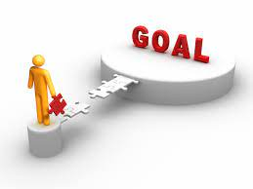
Goals:
Perform Exploratory Data Analysis(EDA) on the dataset
Create and efficiently train our CNN model
Show the accuracy, F1 score, and prediction of the model
Compare the testing scores, vs epochs

Slide 6

Background: Convolutional Neural Network
Notes:
A Convolutional Neural Network is a deep learning algorithm, which receives an input of an image in the model and assigns the importance of the different aspects of the image using filters or specific features to differentiate the image from others. The role of the ConvNet is to reduce the images into a form which is easier to process, without losing features which are critical for getting a good prediction. CNN makes possible to scale massive amounts of data while keeping those unique features of the image, which is a crucial point of getting an accurate prediction. CNN extracts high level features by using these convolutional layers. The first layer extracts the edges, color, and gradient orientation as well. With these features we could either reduce in dimensionality as compared to the input (Valid Padding) or the dimensionality is either increased or remains the same (Same Padding). The pooling layer is responsible for reducing the spatial size of the Convolved Feature. This reduces the machine processes of the massive data it was given. There are two types of pooling, Average and Max Pooling, Average takes the average of all the vales in that portion , and mx takes the max of each portion. Max pooling creates a noise suppressant which makes max pooling the better option than average. Lastly, adding a Fully-Connected layer is a (usually) cheap way of learning non-linear combinations of the high-level features as represented by the output of the convolutional layer. Now that we have converted our input image into a suitable form for our Multi-Level Perceptron, we shall flatten the image into a column vector. The flattened output is fed to a feed-forward neural network and backpropagation applied to every iteration of training. Over a series of epochs, the model is able to distinguish between dominating and certain low-level features in images and classify them using the Softmax Classification technique.

Slide 7

Problem ? Solution ?
The problem of our project is to create a Convolutional Neutral Network that will accurately recognize 7 expression: Happy, Anger, Disgust, Fear, Sad, Surprised, Neutral.
We will solve our problem by rigorously tuning the parameters, to produce high testing scores

Slide 8
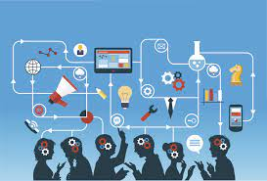
Methodology
Download dataset through google Collaboratory
Unzip folder containing dataset
Exploratory Data Analysis (EDA)
Locate where images are in folder
Identify names of categorized images
Call image according to category
Investigate how many images are in the folder
Make models and call summary
Read and review model accuracy
Interpret visualization for a better understanding

Slide 9
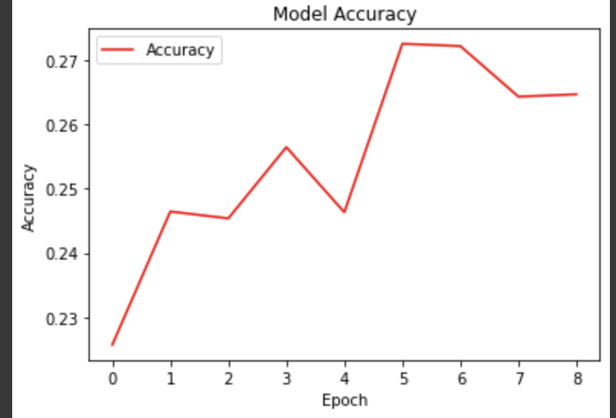
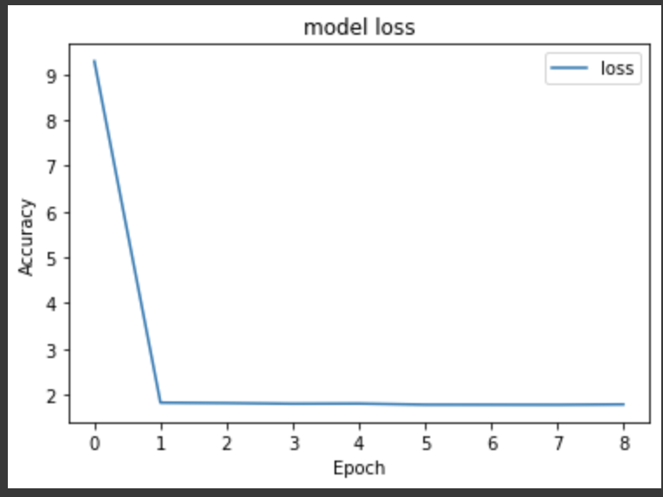
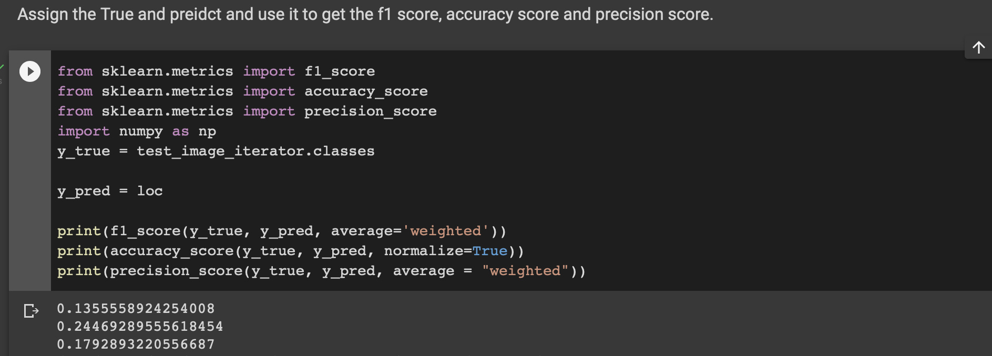
Model 1
Training Accuracy : 0.2646
Loss: 1.7828
Epochs : 10
Early stop at 9 Epochs
Changed: Started with a premade CNN model.
F1:
Testing Accuracy:
Precision:

Slide 10
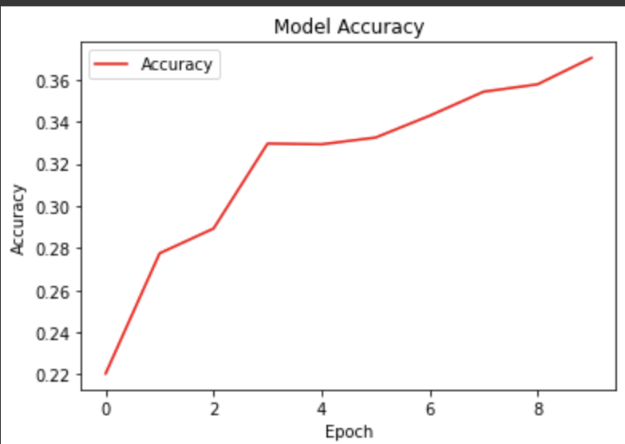
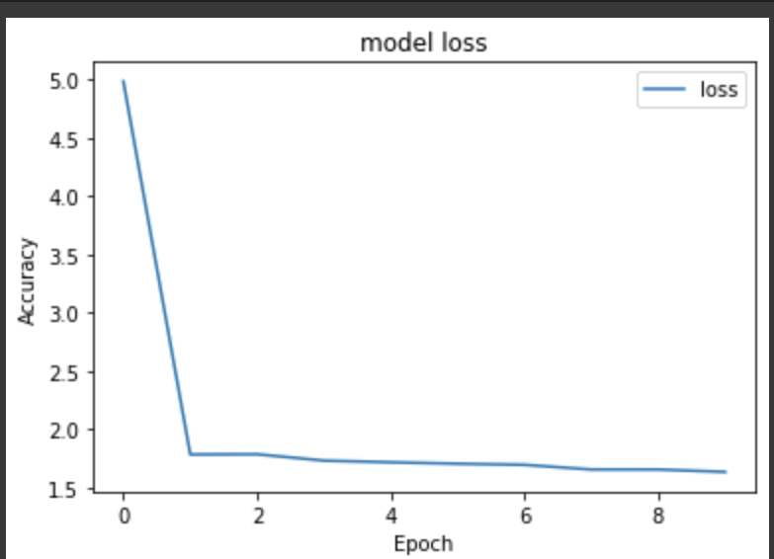
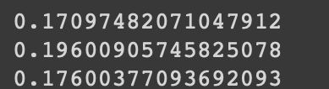
Model 2
Training Accuracy: 0.3704
Loss: 1.6355
Epochs : 10
Changed: added a (2,2) to Max Pooling 2D layer
F1 score:
Testing Accuracy score:
Precision score:

Slide 11
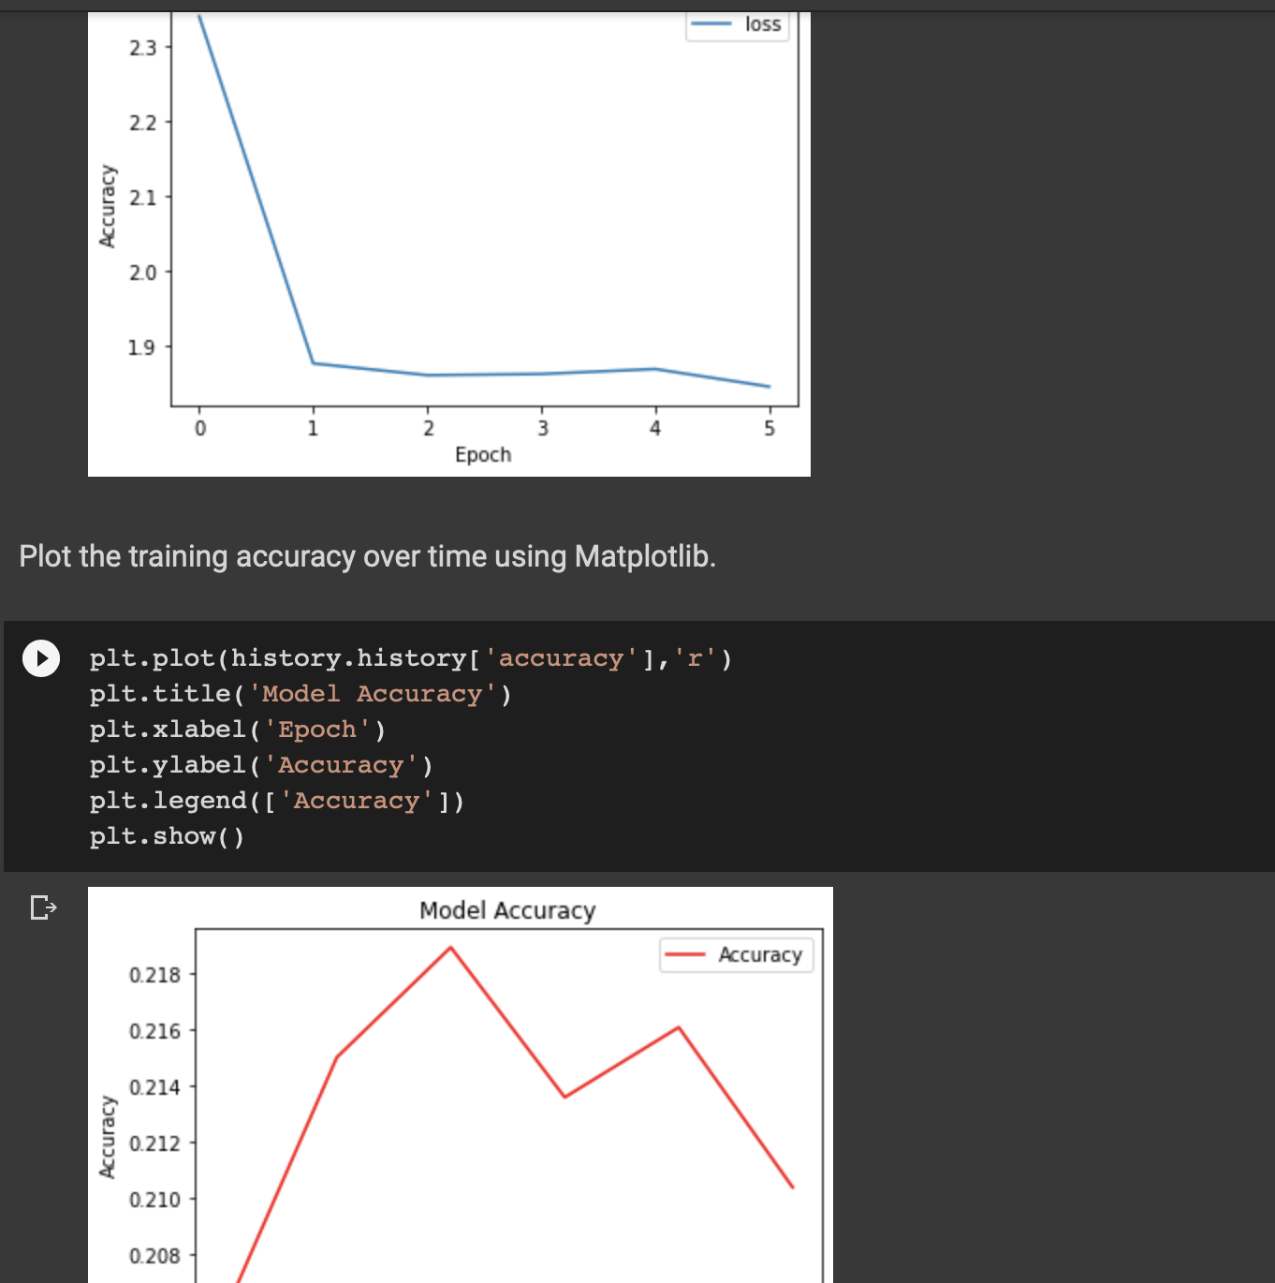
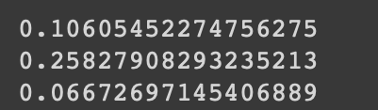
Model 3
Training Accuracy : 0.2104
Loss: 1.8443
Epochs : 10
Changed: the activation function to "tanh" to train the data closer to zero in hopes to improve the accuracy.
F1 score:
Testing Accuracy:
Precision :

Slide 12
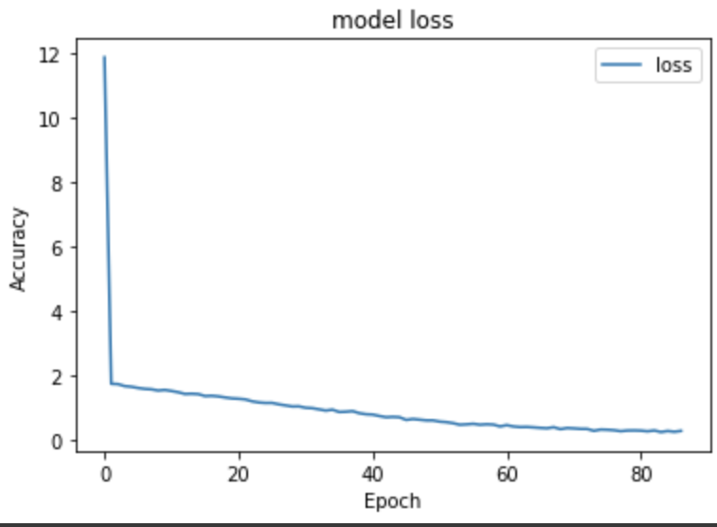
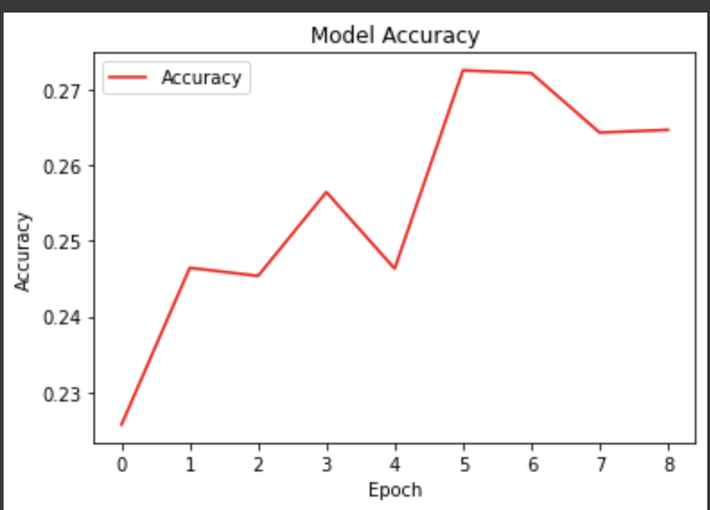
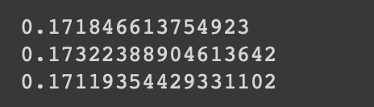
Model 4
Training Accuracy : 0.9257
Loss : 0.2564
Early stop at 87 Epochs
Epochs : 100
Changed : removed the 2D pooling layer inputs, added more epochs to increase the accuracy, was able to get the accuracy to .92. But this was a huge increase in accuracy.
F1 score :
Testing Accuracy :
Precision score:

Slide 13
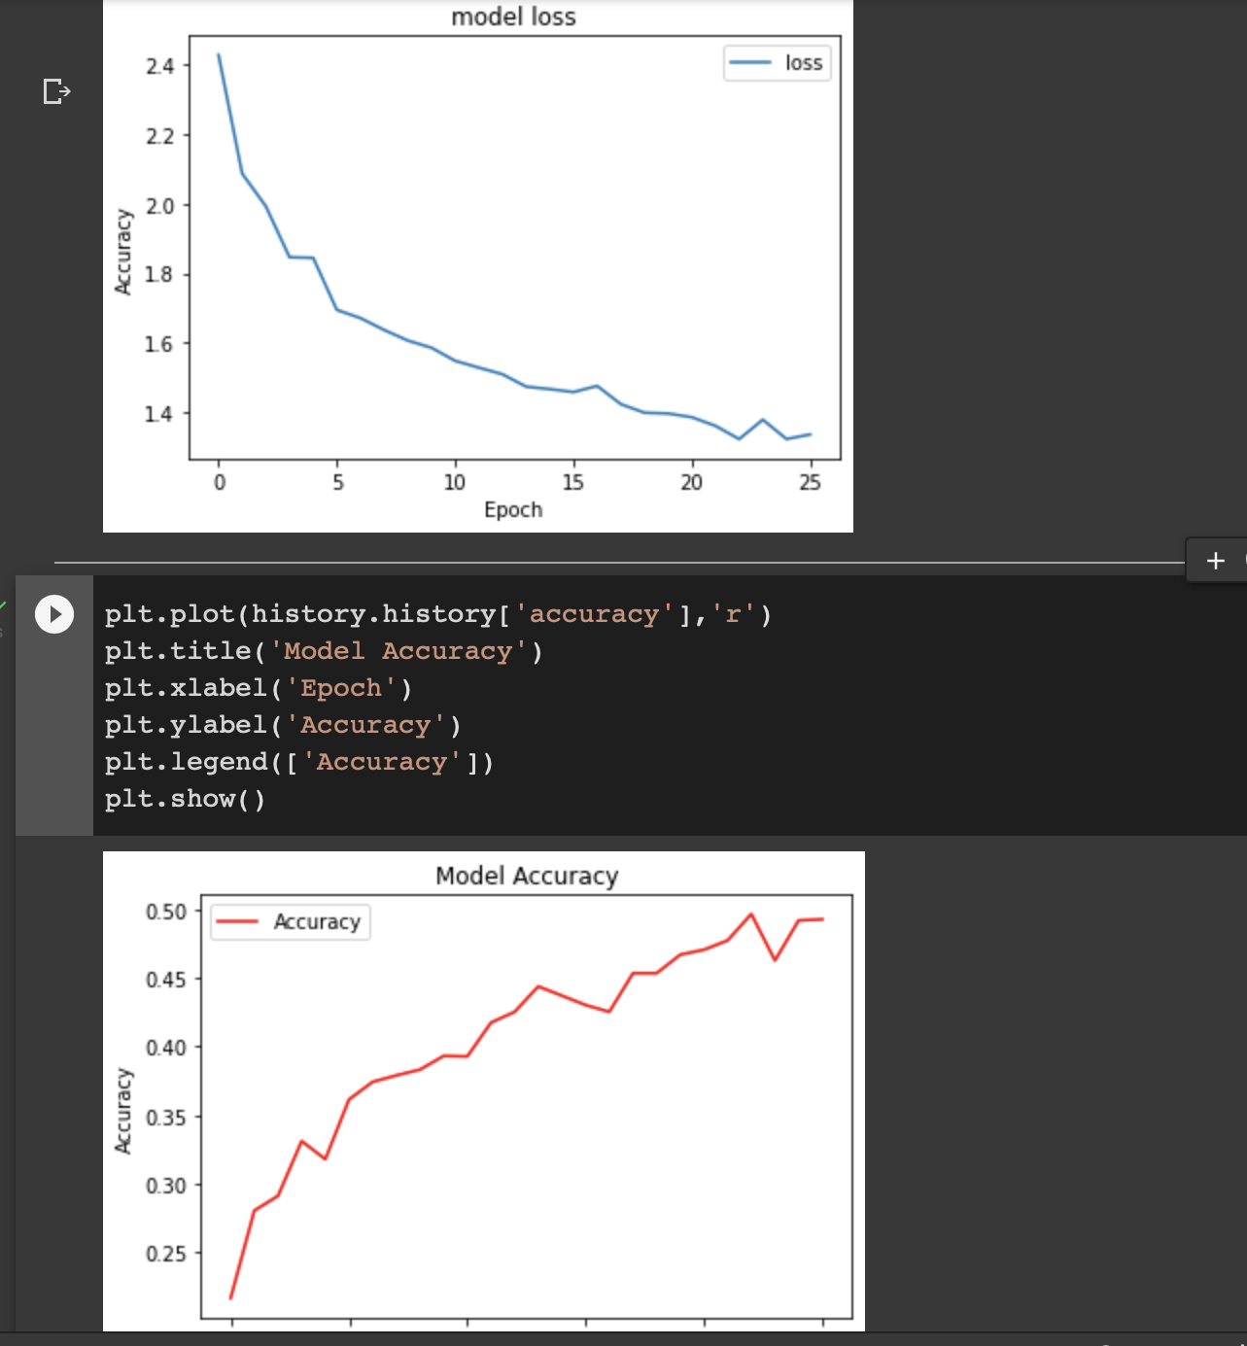
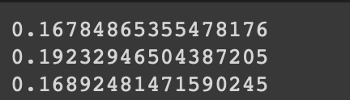
Model 5
Training Accuracy : 0.4929
Lr (learning rate) : 0.0010
Loss : 1.3371
Stopped early at Epoch 26
Epochs : 100
Changed : Added more layers such as pooling layers, more dense layers, dropout, Batch Normalization, 2D Conv2D inputs, and learning rate.
F1 score:
Testing Accuracy:
Precision Score

Slide 14
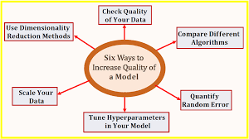
Why This Model?
We chose model 4, because it had the best Training accuracy and loss than any other model we created.
To get to this model we tuned the parameters by adding more layers and epochs, added early stopping, changed activations and optimizers.

Slide 15
Real-World Situations:
Marketing
Manufacturing
Health Care
Emotion recognition technology helps businesses get more out of focus groups by analyzing the facial expressions of testers who use products and display ads.
Automakers can also take advantage of emotion recognition technology. The cars warn drivers when they fall asleep and help avoid dangerous accidents. Road Rage can also trigger a warning If a human driver becomes overly emotional or the driver's condition becomes unstable, the autopilot can intervene and warn the driver.
Detecting the emotions of people with sensory impairment, prosopagnosia, remains a challenge, as it is difficult to generalize and model. As of today, there is no way of curing prosopagnosia but with the help of an emotion classifier it is possible to train people suffering with this disease to better recognize emotions

Slide 16
Our Obstacles:
Constructing our model to run a high training and testing accuracy.
Creating or finding enough space to handle such a large dataset.
Figuring out ideas for modifications that help with the biases in the model.
Finding the most effective activation functions.

Slide 17
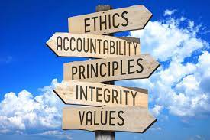
Ethical implications:
One bias of the model is that it is not specific to different cultures, which could cause an issue because different physical traits that vary from person to person give different results
One way we could modify the dataset to mitigate the bias is including information such as race, culture, gender, and age

Slide 18
Our Takeaway
A convolutional neutral Network is best in categorizing date but struggled to perform well on our data.
Managing a large dataset was difficult, it was a challenge to raise the training accuracy scores and testing scores.
Facial Expression Recognition can be useful in things such as consumer data science and psychology
Notes:
After examining the data, we had to choose between learning models because of how broad our topic is, we chose linear regression models in order to see the best fit of truth data in comparison to current phone location.
We also had some trouble uncovering the truth data to compare the raw data to. Managing a large dataset is much more difficult than we had initially thought

Slide 19

Future work
Improve scorings after the data was tested, to better categorize the data
In the future this could be done by adding more layers and epochs to improve the accuracy and decrease the lost, changing the activation and optimizers, etc.

Slide 20




Platforms:
Google Colaboratory
Kaggle
GitHub
Office 360 PowerPoint
Notes:
To only call the google applied machine learning intensive, intensive would be our understatement of the summer but, these eight weeks have taught us more about machine learning than we could have imagined. While we may have completed our project, we faced struggles when trying to manage our very large dataset, as well as identifying patterns in the data for us to analyze. The raw dataset was over 30 gigs!

Slide 21
References:
Convolutional Neural Network Colaboratory
https://colab.research.google.com/drive/11EEHArXyPZa6hZC8z5LfpsA1-aP482d8#scrollTo=iMidmU_EMUTu
Facial Expression Recognition Dataset
https://www.kaggle.com/datasets/jonathanoheix/face-expression-recognition-dataset
A Comprehensive Guide to Convolutional Neural Networks
https://towardsdatascience.com/a-comprehensive-guide-to-convolutional-neural-networks-the-eli5-way-3bd2b1164a53
https://www.mathworks.com/videos/introduction-to-deep-learning-what-are-convolutional-neural-networks--1489512765771.html?ef_id=Cj0KCQjwidSWBhDdARIsAIoTVb1UdcO5d3WMhDUdel2Dx3jvgVlu1P04Yl9vN5e88b-Z94MJ2MSrBP4aAoP6EALw_wcB:G:s&s_kwcid=AL!8664!3!591866074057!e!!g!!convolutional%20neural%20network&s_eid=psn_57384017272&q=convolutional%20neural%20network&gclid=Cj0KCQjwidSWBhDdARIsAIoTVb1UdcO5d3WMhDUdel2Dx3jvgVlu1P04Yl9vN5e88b-Z94MJ2MSrBP4aAoP6EALw_wcB
https://stats.stackexchange.com/questions/126238/what-are-the-advantages-of-relu-over-sigmoid-function-in-deep-neural-network
https://urldefense.proofpoint.com/v2/url?u=https-3A__www.itbusinessedge.com_business-2Dintelligence_value-2Demotion-2Drecognition-2Dtechnology_&d=DwIFAg&c=0CCt47_3RbNABITTvFzZbA&r=taQm9WmeHKa0wq3AL4jzS13z22aDwJSm3do-7aXixoc&m=3qtscY95gU3rz5eifUSsproLnY1dcVRWl3vIcPrAXs19o-Ar1-dy5HbIqJbjQB8t&s=3wkRVHcP1UeKvHB-w-BxHZPS460AVId_B_xaH2I2_Cw&e=
Convolutional Neural Network
https://www.youtube.com/watch?v=YRhxdVk_sIs

Slide 22
Thank You!
We’d like to thank everyone for listening to our presentation. Also thank you to these specific organizations for providing this opportunity to us:
Google
National Action Council for Minorities in Engineering (NACME)
Morgan State University Special Thanks to:
Dr. Babatunde Olubando
Kayla Thames

Slide 23
Questions?

